Slide 1
Lets get back to work!
Randy Dignard

Slide 2
Agenda
Discuss what OHSA says about COVID 19
Discuss standards and guidelines that have been developed
Discuss and show what an “Infectious Disease Policy” would look like
Go through the process of conducting a COVID 19 Risk Assessment
Discuss how to develop a safe work instruction based on your risk assessment
Answer common questions from participants.

Slide 3
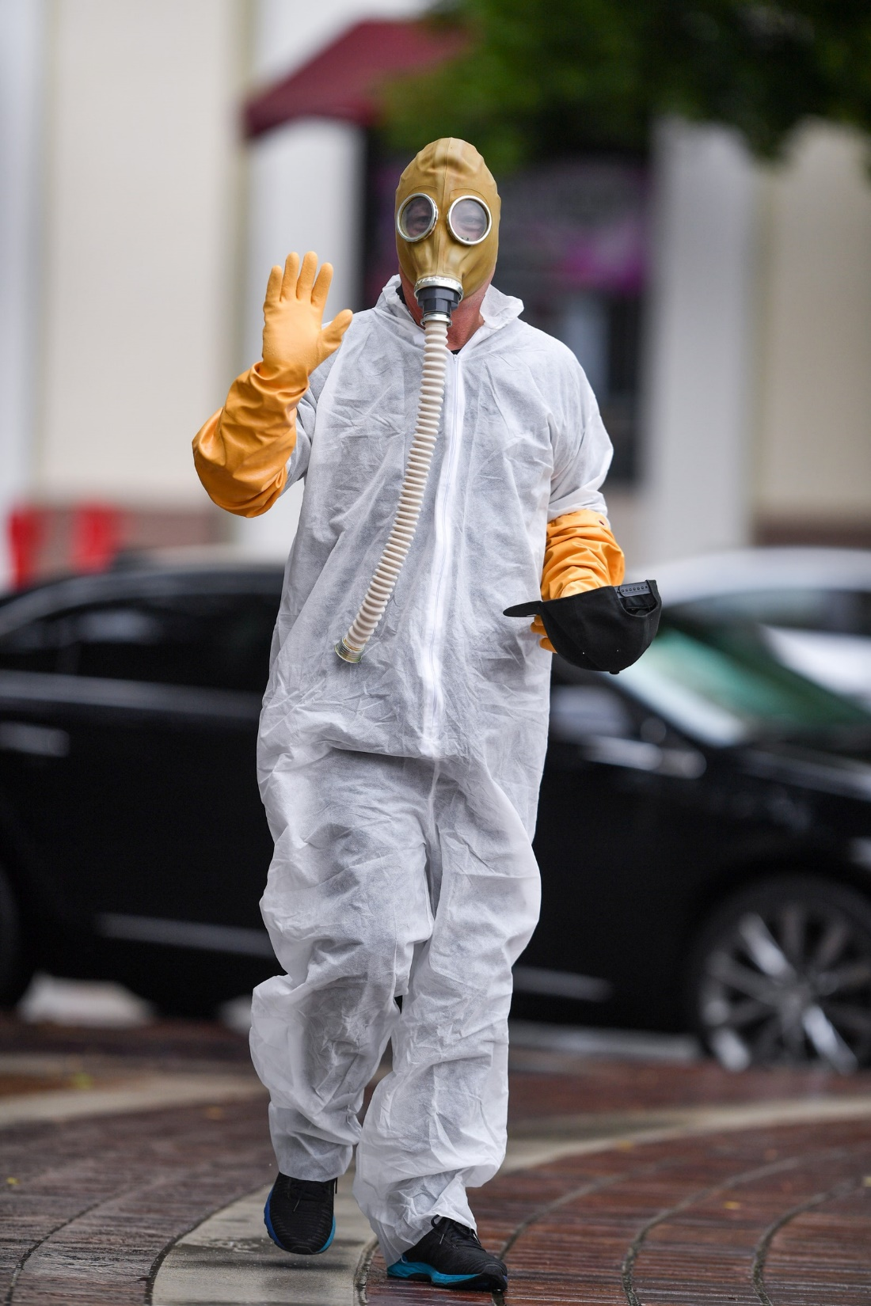
Things Have Changed
Who would have thought?
This is new to everyone, we need to think outside of the box

Slide 4
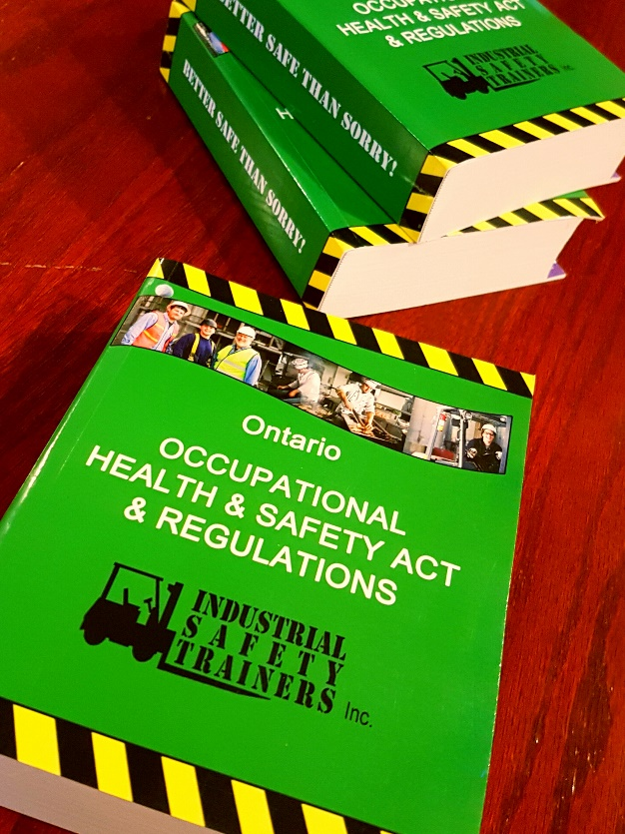
What does the Law say?
Due Diligence - section 25 OHSA
Take every precaution reasonable in the circumstances for the protection of workers
Understand the hazards in your workplace
Train your workers

Slide 5
In the News!
According to the province, the stages for reopening are as follows:
Phase 1: Select workplaces that can "immediately meet" public health guidance and some outdoor spaces such as parks.
Phase 2: More workplaces based on risk assessments, which could include some service industries and retail; and some larger gatherings. This includes the childcare industry.
Phase 3: Further relax restrictions on public gatherings and open all work places "responsibly." Even in this phase, however, "large gatherings such as concerts and sporting events will continue to be restricted for the foreseeable future."
Each stage would last at least two to four weeks, at which point Ontario's chief medical officer of health could then tighten certain restrictions, extend the stage or advise that the province can move into the next phase.

Slide 6
May 19th 2020 Announcement
Capacity per center capped at 50 children
Mandatory staff screening
Restricted access to staff and children only
Outbreak plan locally approved by Public Health Unit
Other screening protocols to be discussed

Slide 7
Childcare centers need to get back to work!
Ministry of Health released a standard on March 29th, updated May 8th: “COVID-19 Guidance: Emergency Childcare Centres”
New standards have been written by the Public Services H&S Association - May 1st 2020
This standard applies to all child care facilities and may leave some centers asking questions.
We will need to ask ourselves, how will this standard apply to my organization?
Lets review the standard:
Guidance During COVID 19 for employers of childcare centres
Precautions when working as a childcare provider
This standard can be downloaded at https://thesafetybus.com/covid-webinar/

Slide 8
Where to begin - Overview
Develop a policy that defines how you will manage the risk of infectious diseases. Include elements such as:
Duties and responsibilities of employer, managers, workers, and contractors
Risk assessments to be completed that identify the hazards and appropriate controls measures - to mitigate exposure
Development of a location specific action plan that manages the identified hazards based on the risk assessment
Training that will be provided to workers

Slide 9
Assess your exposure to the disease
Conduct a risk assessment that is focused on COVID 19:
Involve the JHSC or H&S Representative
Assessment should be specific to your workplace/location
Include a mental health/emotional aspect
Reassess as often as needed; we are all new to this

Slide 10
Create An Action Plan
The action plan should be as specific as you can make it
You will need to modify it as often as necessary.
It will need to be communicated to staff and clients if changes are made.

Slide 11
Other Considerations
As an employer, supervisor, or manager - we must understand that workers are worried, scared, and emotional
Staff are looking to you for support
Your attitude towards what is going will be key to how your workers react to this new hazard
Be that person that workers can go to if they have concerns

Slide 12
Other Considerations
Be aware of the fluidity of this situation - Businesses and staff resources must be innovative - The risk assessment performed yesterday may change today to reflect new information
Strive for continuous improvement
Risk Assessments and recommendations must be reassessed as often as necessary to ensure that all control mechanisms are functioning optimally at all times
Acknowledge the significant psychosocial impacts of the pandemic - Be prepared to deal with mental health issues.

Slide 13
Other Considerations
Employers must report all known positive test results for COVID-19 to:
the Ministry of Labour (in writing) within four days
the Joint Health and Safety Representative
a Trade Union (if applicable)
Employers will need to update their policies and procedures pertinent to pandemics.
Assistance from the JHSC to ensure these hazards are controlled is required.
Consider how the workplace will achieve normality.
Decide when and how to reduce the need for controls like distancing, enhanced cleaning etc.
Define these decisions within the policy and procedure.

Slide 14
Questions we hear…
“What types of PPE will we require working with children in the childcare?”
“I just heard that staff at the emergency child care centres are required to wear surgical masks when physical distancing isn’t possible.”
“Children can cough or sneeze suddenly with no covering of their nose or mouth. Would a face shield and gown be recommended?”
“For PPE, is it the schools responsibility to provide? I am assuming yes. If that is the case, do we get any funding for this? Do you suggest a supplier or do we source on our own?”
“Will cloth masks be ok or do they have to be paper?”

Slide 15
“Are the staff to be surveyed for Covid-19 symptoms each morning upon arrival into the centre? Temp taken, questions?”
“Should we procure ourselves a specific thermometer?”
“Shall we be expected to take children's temperature 1, 2 or 3 times a day?”
“Is Ethyl Alcohol Gel, mandatory? Even for kids under 6?”
“Have hugs been made illegal?”

Slide 16
“Should staff require an initial test to confirm Covid-19 presence prior to starting work? And the children too?”
“If someone has tested positive that staff has been exposed to in the centre does that mean the Centre will be closed for 14 days for isolation? Or just those in immediate contact with staff?”
“Do we have to reopen in June if we get the go ahead? Can we wait until September?”

Slide 17
“Is sensory play (water tables, etc.) prohibited at this moment?”
“Will each child be required to have their own creative, certain toys and lunch/snack?”
“Who would be required to prepare the snacks/lunch or do we need to cater in?
Or one person handles this such as our cook? Will there be elimination of staff allowed in the kitchen?”
“Is there eliminating furniture within the room to coincide with smaller ratios of children?”
“I am sure our disinfecting will increase and should the toys be disinfected many times through the day?”
“Our Centre is located in a church. Other groups use the same common spaces in the evening. They also use our classroom space, What will be the protocol for that? For instance, how often do floors need to be washed?”

Slide 18
“Procedures / options for healthy staff who opt not to return to work even if the center is following all prescribed safety protocols? Is the center obligated to save their position or should staff be laid off?”
“If staff refuse to come back because of Covid-19 is that grounds for dismissal?”
“Can an employee refuse to return to work once we reopen the childcare centres?”
“Procedures/ options to address an unforeseen staff shortage leaving the center unable to meet mandatory staff / child ratios or enough staff to maintain prescribed safety protocols. Example - 2 staff call in sick. Can the center advise clients in advance that the child care service is contingent on availability of required staff and may be subject to change with no or little notice?”

Slide 19
“My question is if we must have only one teacher per group, how does that teacher get a break in the day?”
“What happens when we must get a supply teacher when that teacher is sick? Teachers are often sick and finding supply a teacher was a problem even before the pandemic.”

Slide 20
For More Info….
Health Canada
Public Health Ontario https://www.publichealthontario.ca/en/diseases-and-conditions/infectious-diseases/respiratory-diseases/novel-coronavirus
World Health Organization https://www.who.int/emergencies/diseases/novel-coronavirus-2019
See other contacts and links on the Public Services H&S Association guide lines for child care facilities.

Slide 21
Coming Soon: Something exciting!
Industrial Safety Trainers will be proud to offer Distance Learning for JHSC Certification Training.
This is something new for Ontario, training via a ZOOM face to face learning.
Get Certified from anywhere!
We are here to help, contact our office at Hello@istcanada.ca

Slide 22
Download Risk Assessment and Policy
For a copy of this presentation and risk assessment go to:
https://thesafetybus.com/covid-webinar/
Randy@ istcanada.ca

Slide 23
Thank you for attending this workshop!!

